Slide 1
Telecom Customer Churn rate – how to discover who’s leaving
Project by David Trinh
Notes:
This is a project about customer churn rate within a fictional telecom company. The goal of the presentation is to introduce a machine learning method to discover the customer profile that is most likely to leave in order to focus efforts of retaining them.
The target audience for this presentation would be upper management who determine what programs to run and where to focus resources.

Slide 2
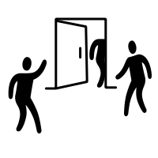
The problem at hand
26.54% of our customers churned within the past month vs 21% industry average
Acquiring a new customer can be up to 5x more costly than keeping an existing one
Notes:
The churn rate this past month was 26.54% while the industry average is only 21%, meaning that we are underperforming our competitors by 5.54%.
While an easy solution would be to simply add more customers, it would be too costly. It’s much more cost efficient to try to retain our existing customers than acquire new ones.

Slide 3
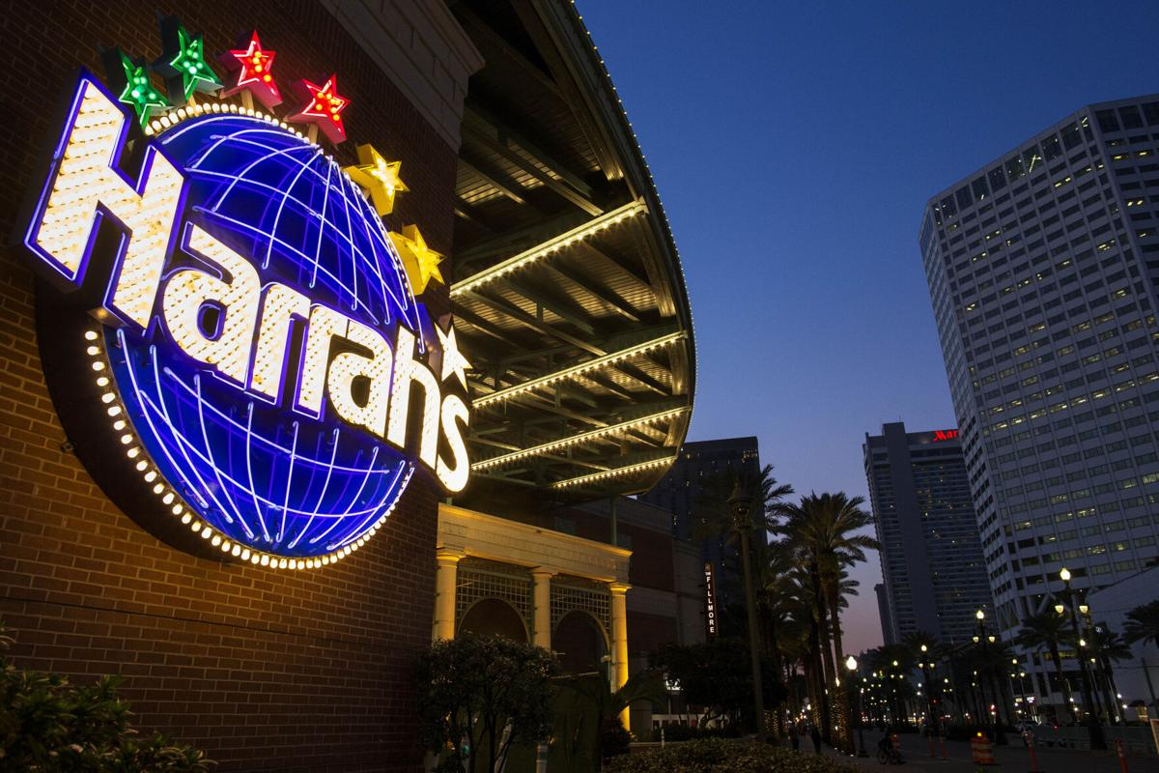
Data-driven decisions
Need to focus efforts
Customer base is too varied, intuition will only go so far
Need to incorporate data into decision making
Notes:
Instead of conducting a retention plan on the mass of existing customers, we should just focus on those likely to leave. This is more cost effective, and we could potentially tailor efforts to the customer segment most likely to leave for better results.
Intuition alone is no longer sufficient for decision making. With data, we are able to test our intuitions to see if they’re correct. Prime example is Caesars Entertainment, formerly known as Harrah’s.
Harrah’s was able to use data analytics to become one of the largest gaming companies. Data drove this growth. Specifically, the Total rewards loyalty system.
What they discovered was that the big money didn’t come from the big shot executive types, it was from the locals. The aggerate of small customers accounted for over 80% of the revenue.
Imagine what would have happened if Harrah’s would have focused their resources on the so-call big money customers, and left the loyal locals behind.

Slide 4

bigml
What is it?
Simply Machine Learning Platform
Why use it?
Determine the most optimum model
The results?
Confidently target correct market segments
Notes:
So the big questions is how do we incorporate data into our decision making? That’s where Bigml comes in.
What is bigml? Bigml is a scalable machine learning platform that’s made beautifully simple for everyone.
Why use it? It allows us to quickly create models with several analytical techniques to predict which of our customers will leave. Even better, it can run through several model combinations to determine which is the most optimized model
The results? We will be able to determine the customer segmentations that are most likely to leave with a quantifiable degree of certainty. With this information, we are then able to make better business decisions and deploy resources efficiently to retain those customers

Slide 5
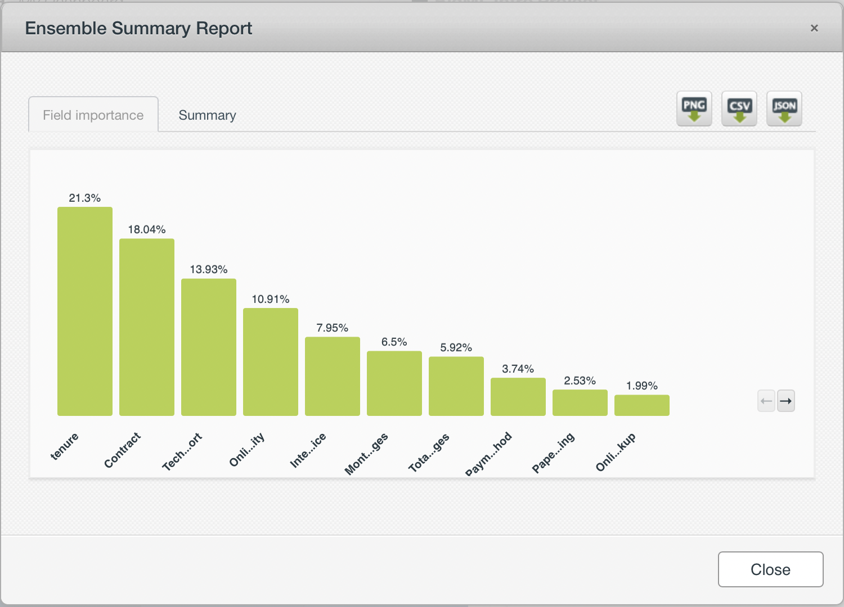
The data
Includes information on over 7,000 customers with 21 describing features
Data prep:
Dataset was very clean, with no missing values
Eleven features with less than 5% importance
Train/Test Data split
Notes:
We have data on over 7,000 customers with 21 describing features. This includes gender, tenure, contract type, etc. The data also contained no missing values, so little data cleaning was needed. The variable that we are ultimately most interested in is churn, whether or not a customer left. This is what we will call the ‘Dependent Variable’ in the model.
From the graphic, we can see that not all variables are the same. Some have a higher importance in determining out dependent variable than others. In fact, we have 11 features with less than 5% importance. However, when I removed these variables the model accuracy got worse, but not by a significant margi (<2%). While these features appear to be significant, if there was ever a case where the cost of modeling or data storing because too cost prohibitive, you could remove these features without too much detriment to the overall model
I also split the data 80/20. I used 80% of the original dataset to train the model, and the other 20% to test the model. This is done to truly test the model without any overlapping data.
Data was sourced from BlastChar, B. (2018, February 23). Telco customer churn. Kaggle. https://www.kaggle.com/blastchar/telco-customer-churn.

Slide 6
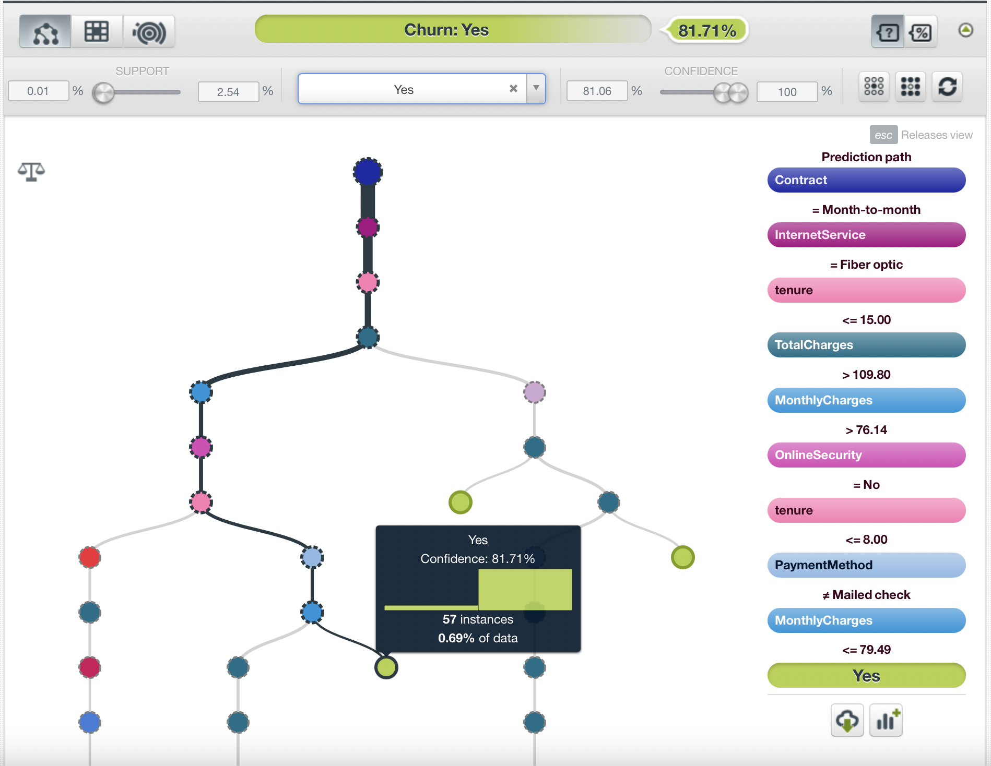
The module
Base Model: The decision tree
like a flowchart of probability
Can tell if a customer will leave based on various attributes
Is this the best model?
Good first step, but additional model tuning is required
Notes:
The first model that we produce is a basic decision tree. It can be read like a flowchart of probability. As we go along each ‘branch’, we encounter nodes. Each node represents a feature from out dataset, and can tell us with a quantified confidence level of whether or not the customers in that segmentation will leave. As we go further down the branches, we become more confident in outcomes with the more narrower segmentation.
Our first model will often not be the best model to use. The best will be the result of an ensemble of models , but before we even get to that step, additional model tuning is required.

Slide 7
Model tuning
It is important to restate that our goal: To identify those who are likely to leave
Prioritize model recall over accuracy
Try to minimize false negatives
Weighting data
Only 1/4 of data consists of people likely to leave
A balanced weight compensates for imbalance in data
Increased our recall from 52.3 % to 73%
Notes:
It is important to restate that our goal is to identify those who are likely to leave so we can act solely on them. In order to do this, we need to jump ahead a bit and realize that we need to prioritize recall over accuracy. Recall is the percentage of true positives over total positives, thus we want a high recall, even at the sacrifice of a bit of accuracy.
It is also important to note that the data only contains a lot of information about customers who stay, but only ¼ are about those who leave. This imbalance in data also creates an imbalance in the model. To compensate for this difference, we add a balanced weighting across all classes. By doing this, we are table to increase our recall from 52.3% to 73%, a considerable amount!

Slide 8
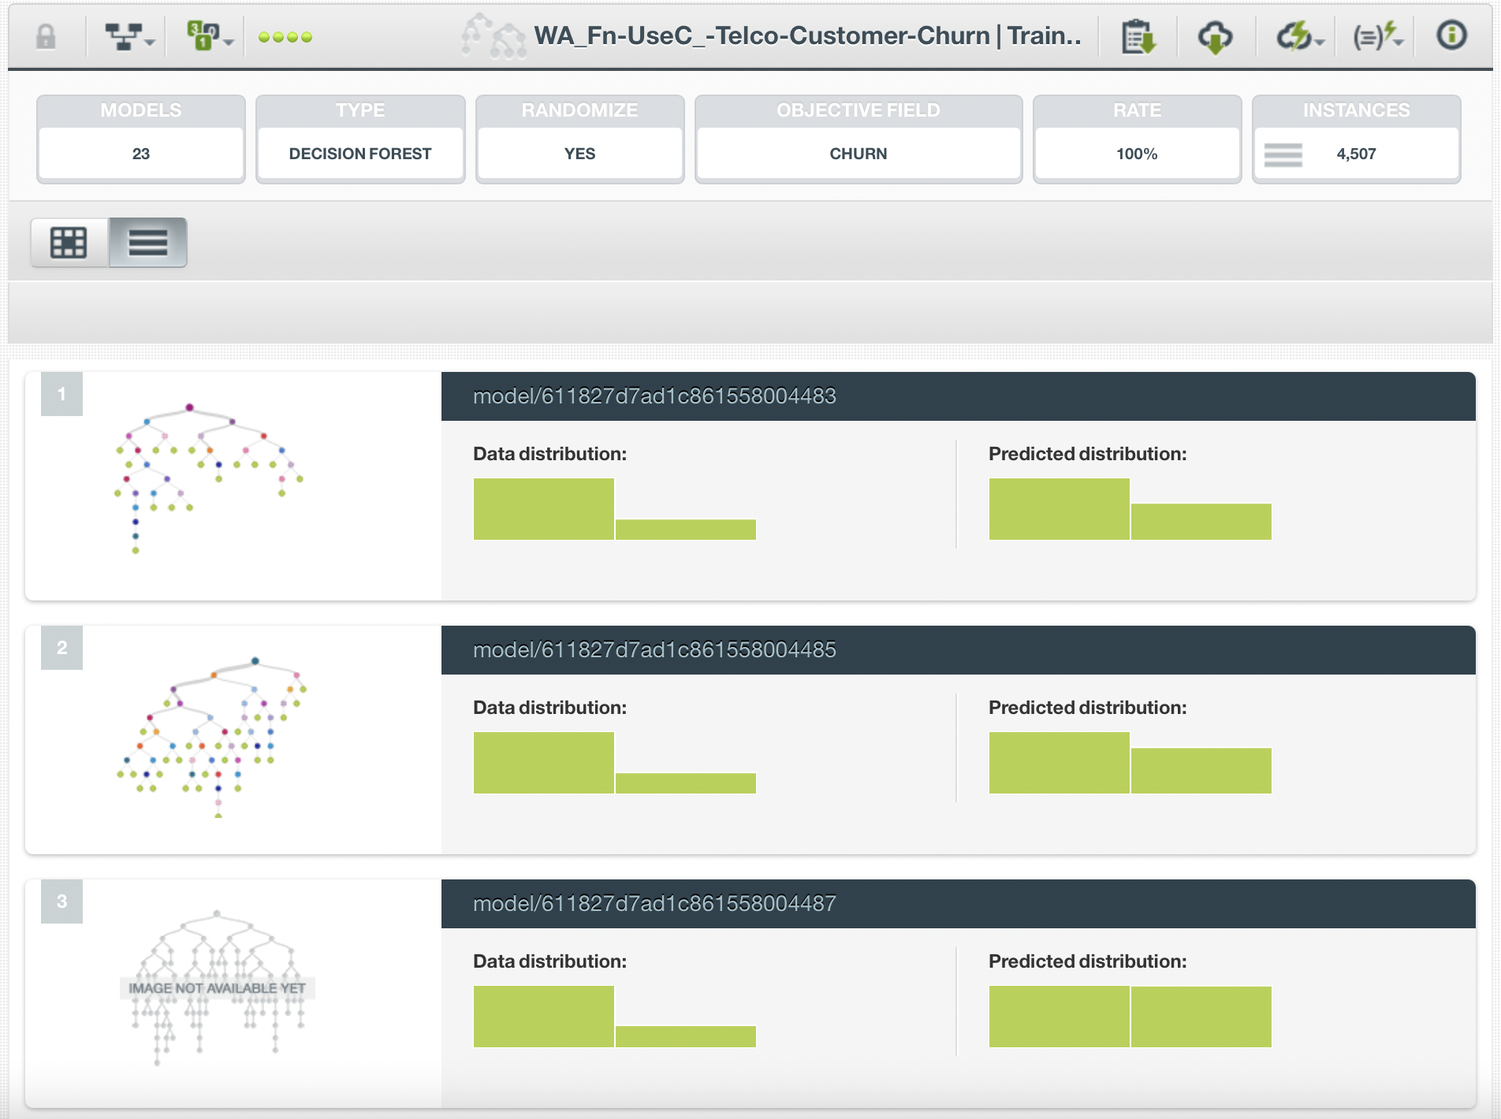
Model Ensemble
Why do we want an ensemble?
How do we find the best one?
OptiML
Increased recall from 73% to 78.9%!
Notes:
An ensemble is a collection of different decision trees to create a better model with a stronger prediction confidence. One great benefit of using an ensemble over a single model is that the ensemble will be less sensitive to outliers in the data. However, it is also prone to overfitting. This is one reason why we split the data initially to test our models.
So how do we find the best combination of models? Having to go through potentially hundreds of model combinations would be extremely time consuming. Luckily, we can use BigML to automate this process by utilizing a function called OptiML.
What OptiML does it go through hundreds of different models in order to find the most optimal ensemble. Then we can pick what model best fits our needs, and in this case it’s the ensemble that has the highest recall percentage.
What we end up with is a decision forest that contains 23 different models, and an increase of our recall percentage from 73% to 78.9%.

Slide 9
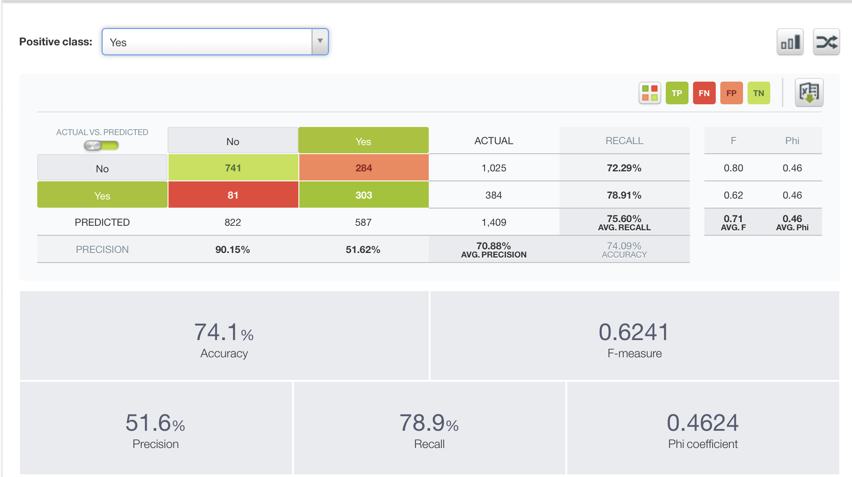
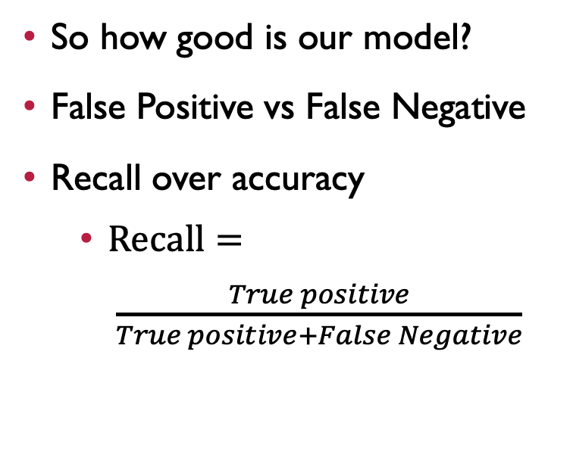
Evaluation
So how good is our model?
False Positive vs False Negative
Recall over accuracy
$Recall= \frac{True positive}{True positive+False Negative}$
Notes:
So now that we have our model, how do we know how good it is? As mentioned earlier, this is why we had split our dataset into an 80/20 train/test split. Using the model trained from the 80% of data, we can feed the other 20% to the model to see how well it does at predicting the results, which are known to us.
Lets define what a false position and false negative is. In our scenario, a false position is a customer who we predict will leave, but actually stays. A false negative is a customer who we predicted will stay, but actually leaves. Our goal is to retain as many customers as possible, so we are aiming to minimize the false negatives. If this causes an increase in false positives, we can accept this tradeoff since we are still minimizing the churn rate.
This is why we defined our goal of higher Recall over accuracy early on. Recall is defined at the ratio of true positions over the sum of true positives and false negatives, also known as the true positive rate. Thus, the higher the recall, the higher confidence we have that the model won’t miss a customer who is likely to leave. A recall of close to 80% should be sufficient for our needs.

Slide 10
Why use a business Analyst
Base Model
Optimized Model
Notes:
Here I want to show the results of of the model tuning, and why it’s important to have a business analyst involved with the process rather than solely relying on the BigML platform.
If all I did was input the dataset into BigML and trusted the results, you can see that the recall (and false negatives) is significantly worse than our optimized model. In fact, by model tuning and optimization, we increased out recall rate by 50% and decreased out false negatives by 55%! What’s even more impressive is that it only came at the cost of 3.5% from out accuracy, an easy tradeoff.
While these tools can drastically help a business, it’s also important to realize that you also need the personnel to best utilize them.

Slide 11
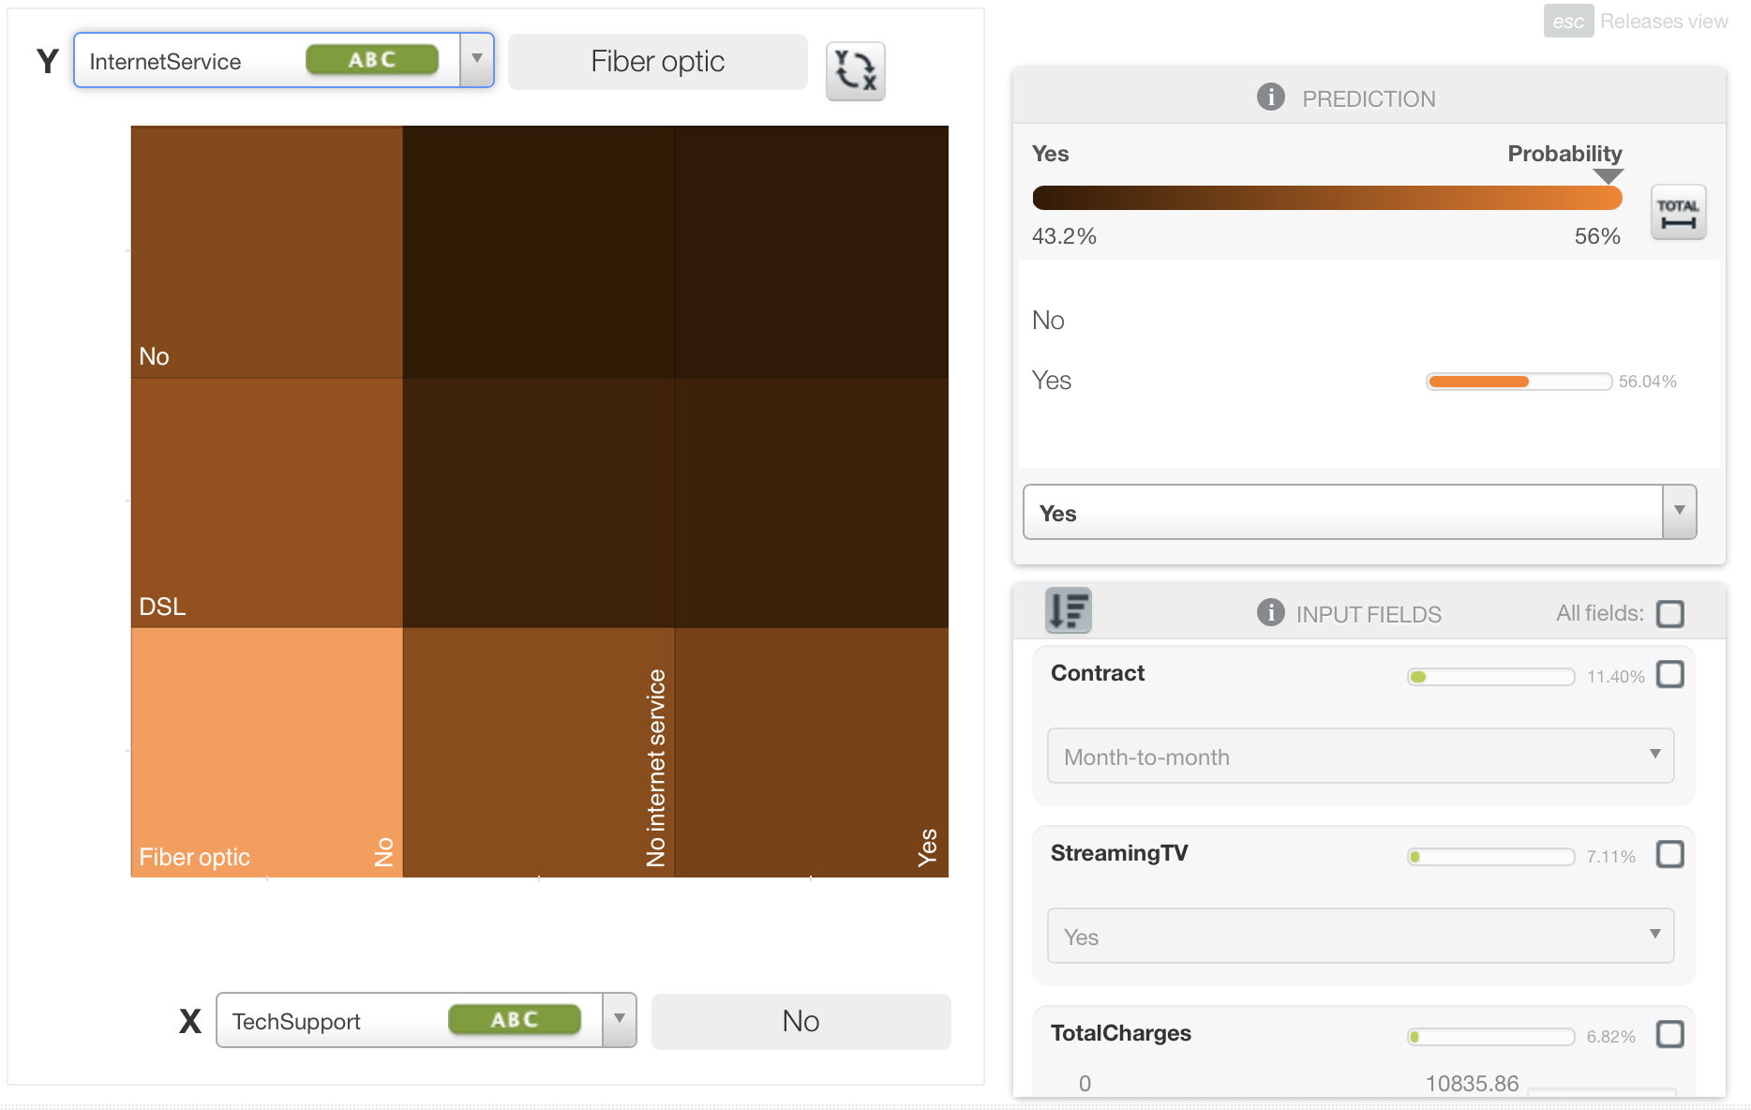
Results
Partial Dependence Plot (PDP)
shows probability of customers leaving on a gradient scale
Notes:
So while this is all great, what are the results? What does all of this fancy machine learning models and algorithms tell us? Who do we focus on?
One very useful graphic produced is the Partial Dependence Plot (PDP). We can easily see the probability of a customer leaving on a gradient scale based on several different attributes.
If we look at those who’ve had tech support within the past month and the type of service they have, we can see that those who have fiber optic but haven’t received any tech support are the more likely to leave.

Slide 12
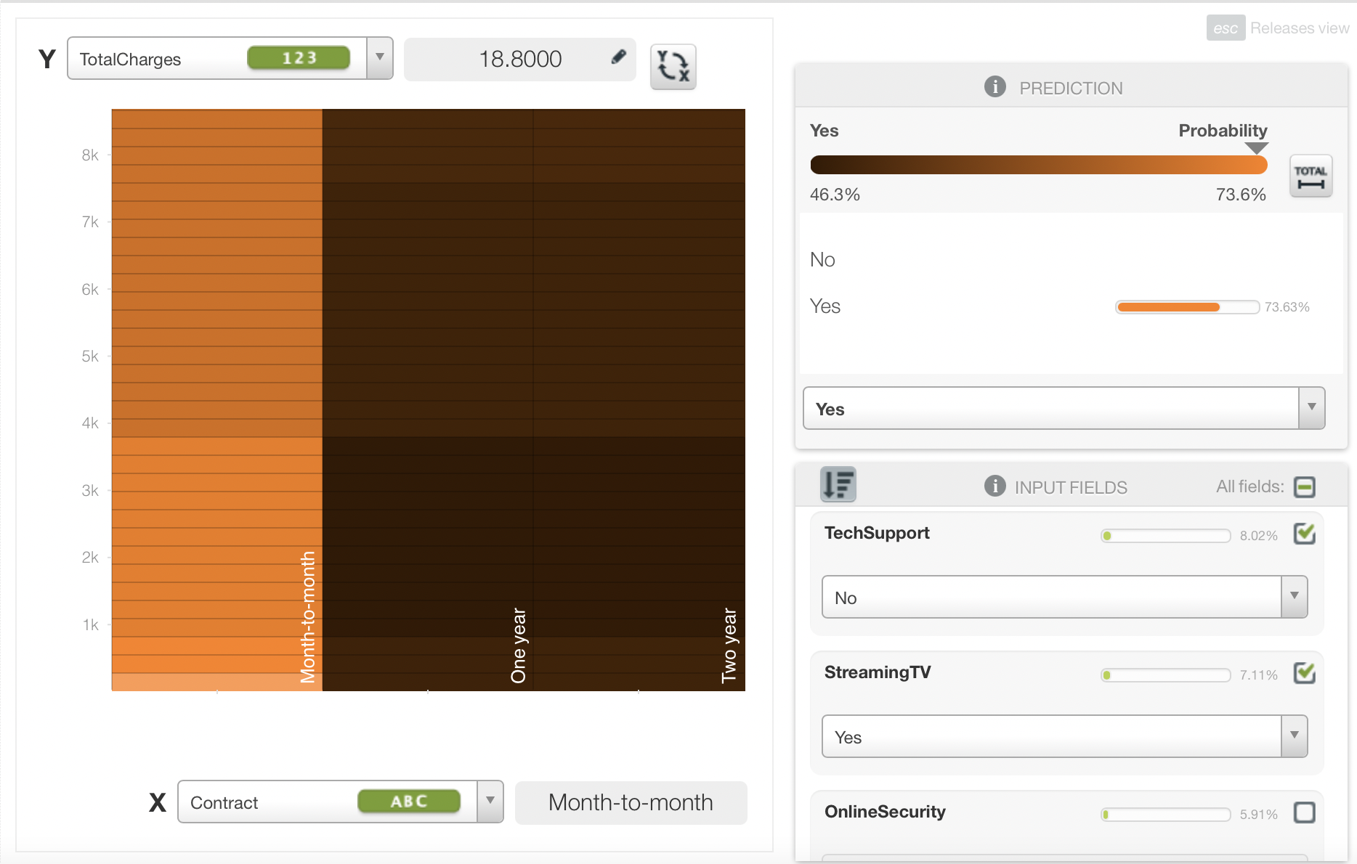
Results
Who are the most likely to leave?
Those on month to month contracts
Lower total charges
Low tenure
Senior citizens
No dependents
No device protection
No tech support
Notes:
After going through all attributes, I’ve determine the customer segmentation that is most likely to leave. These are the customers on a month to month contract, lower total charges, have not received tech support with the past month, steams tv and movies, does not have device protection, is a senior citizen, has a low tenure with the company, uses fiber optic service, has no dependents, and utilized paperless billing. We are 74% confident that this is the customer segmentation that is most likely to leave, and should focus efforts on them.

